Slide 1
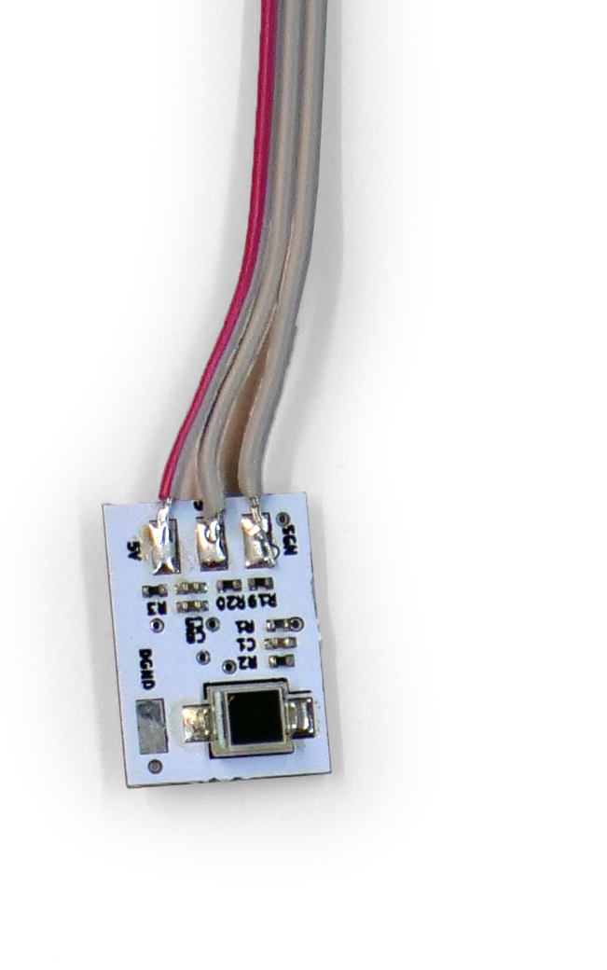
MODULAR FULL-BODY TRACKING SUITE
Roboy-made Lighthouse Sensor
60Hz, 1mm accuracy, external object tracking
BACHELOR THESIS
03.05.2019
Simon Jarc, simon.jarc@tum.de

Slide 2
FINALS SLIDES MUST INCLUDE
- what you planned
(basically the vision video but a bit more technically explained)
- what you achieved
- system design/architecture/important design decisions/approach
- implementation details
(be precise, make it so other techies understand, you have more time than usual, use it here!)
- test results
(how did you measure? and how well did you do vs. those measurements?)
- learnings (I am a better engineer now, because I've learned: …; Had I known this secret trick, my life would have been so much easier.)
- finals video

Slide 3
GENERAL HOW-TO
most importantly: make it awesome
Time limit
10 mins - Teams
5 mins - Theses
Use the template Slides at the end to put graphics etc.
General tips
Try not to have a boring presentation ☺
Make sure you include your final video somewhere.
Fonts size not smaller than 18 (if its smaller you have too much infos on the slide)

Slide 4
WHAT WE WANT
KEEP EMPTY - WE WILL SHOW YOUR VISION VIDEO HERE

Slide 5
MOTIVATION
Record Human Movements
Using SteamVR Tracking 2.0 (Lighthouse 2)

Slide 6
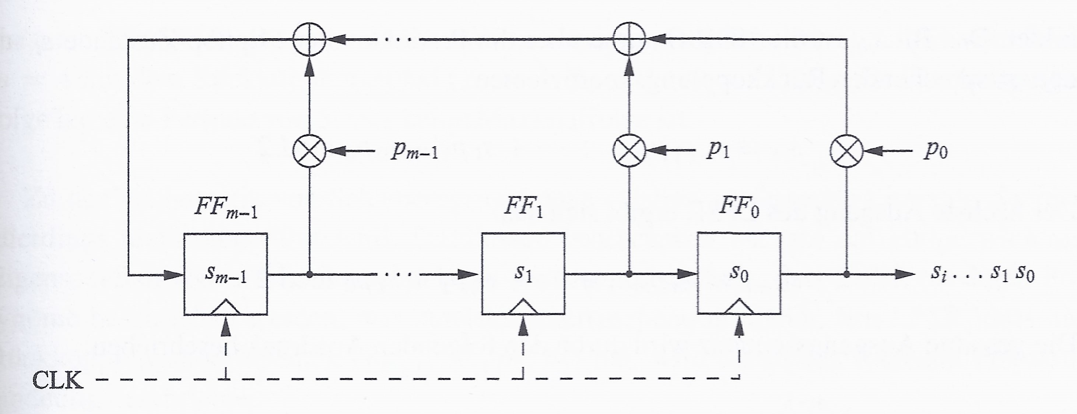
THEORETICAL BACKGROUND
Linear Feedback Shift Register
Figure 1: Schematic of Linear Feedback Shift Register [PP16]

Slide 7
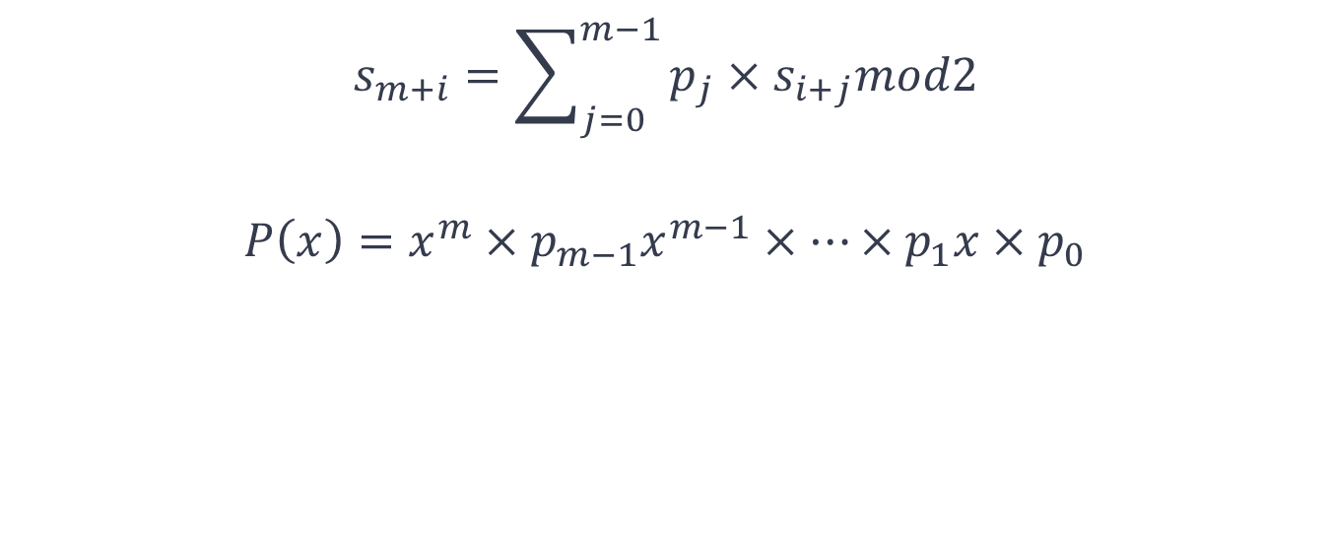
THEORETICAL BACKGROUND
Linear Feedback Shift Register
$$s_{m+i}=\sum_{j=0}^{m−1}{p_{j}×s_{i+j}mod2}$$
$$P\left(x\right)=x^{m}×p_{m−1}x^{m−1}×…×p_{1}x×p_{0}$$

Slide 8
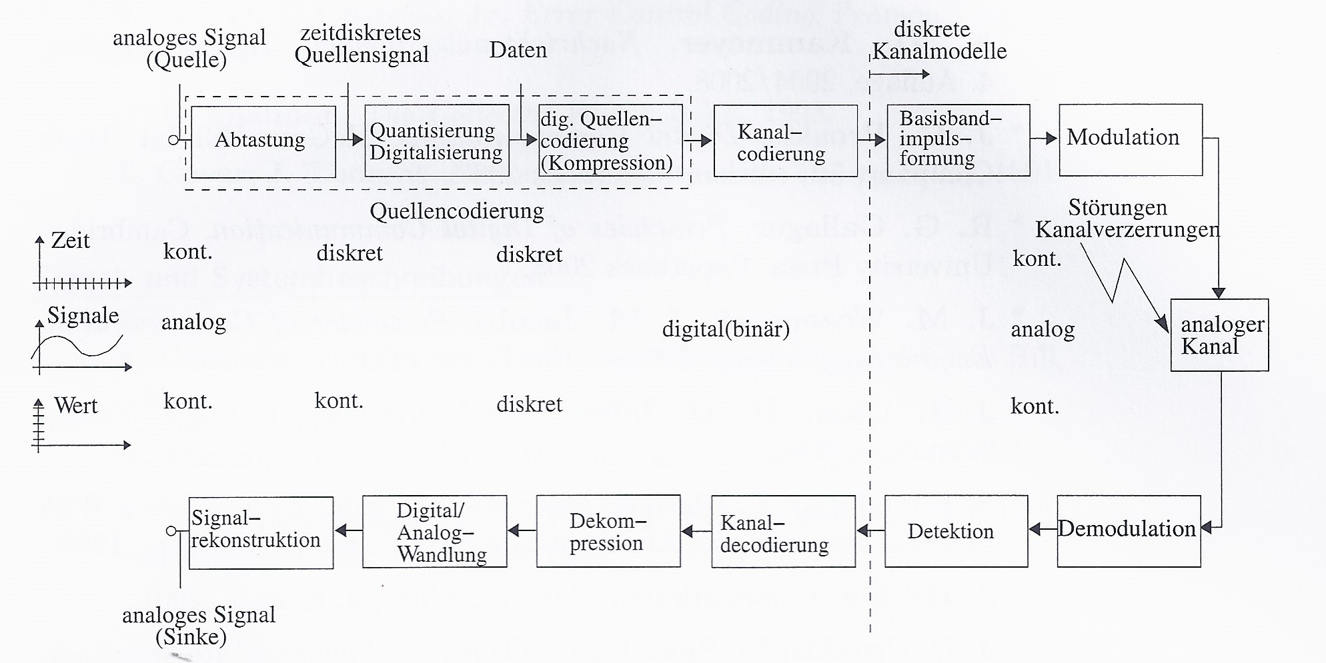
THEORETICAL BACKGROUND
Telecommunication Channel
Figure 2: Communication Link [HKSK20]

Slide 9
THEORETICAL BACKGROUND
Telecommunication Channel
Cryptography: Message is Encrypted
Source Coding: Message is Comprossed
Channel Coding: Increase Tolerance against Errors

Slide 10
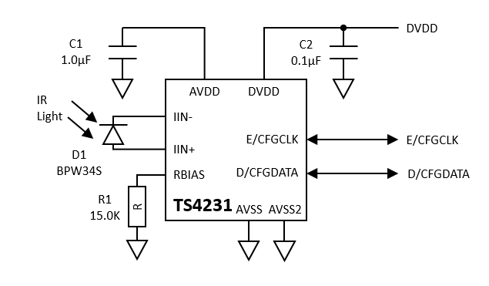
THEORETICAL BACKGROUND
Triad Semiconductor TS4231
Figure 3: Simplified Circuit Schematic [Tri16b]

Slide 11
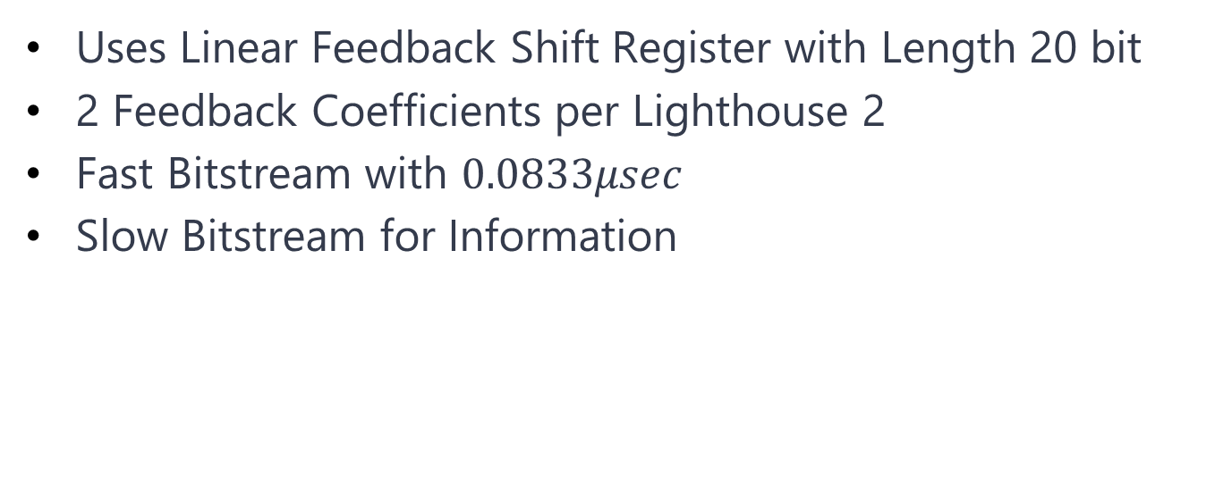
SYSTEM DESIGN
GitHub Discussion
Uses Linear Feedback Shift Register with Length 20 bit
2 Feedback Coefficients per Lighthouse 2
Fast Bitstream with $0.0833μsec$
Slow Bitstream for Information

Slide 12
SYSTEM DESIGN
Photodiode
PIN Diode
Good High Frequency Characteristics

Slide 13
SYSTEM DESIGN
Arduino MKR Vidor 4000
FPGA: Intel Cyclone 10CL016
Microchip ATSAMD21

Slide 14
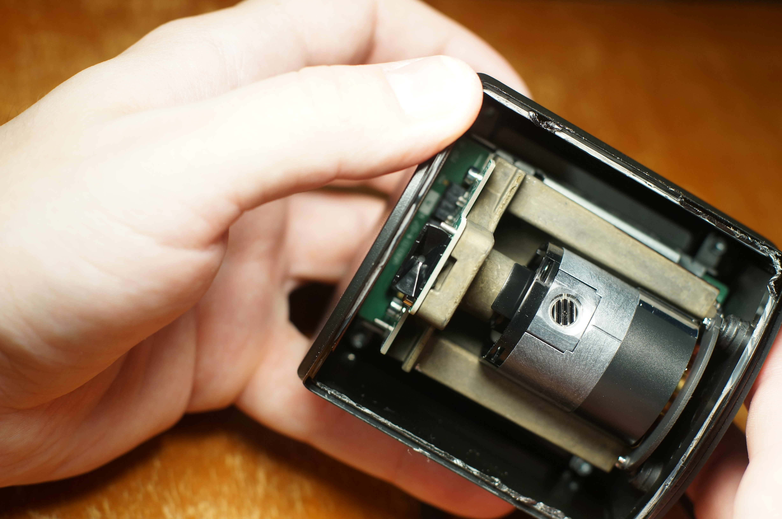
IMPLEMENTATION
Measurement of Laser Signals
Figure 4: Inside Lighthouse 2 after Destruction [.b]

Slide 15
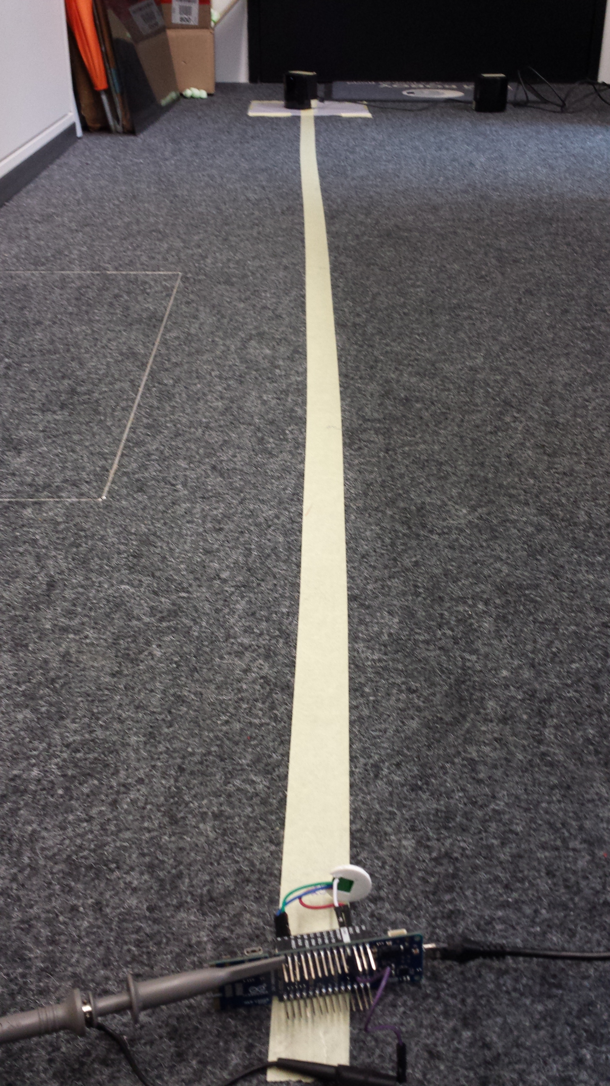
IMPLEMENTATION
Measurement of Laser Signals
6 Different Positions
Recording DAT-Files on Oscilloscop
Evaluation in Matlab
Figure 5: Test Arrangement

Slide 16
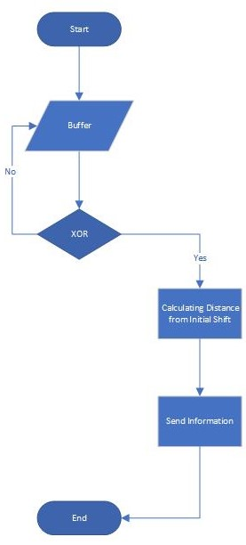
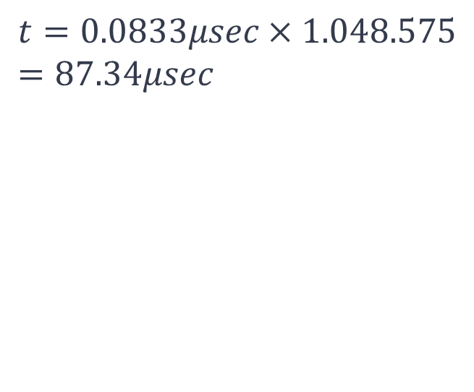
IMPLEMENTATION
Real-Time FPGA Detection
$$t=0.0833μsec×1.048.575=87.34μsec$$
Figure 6: Algorithm for Position Determination

Slide 17
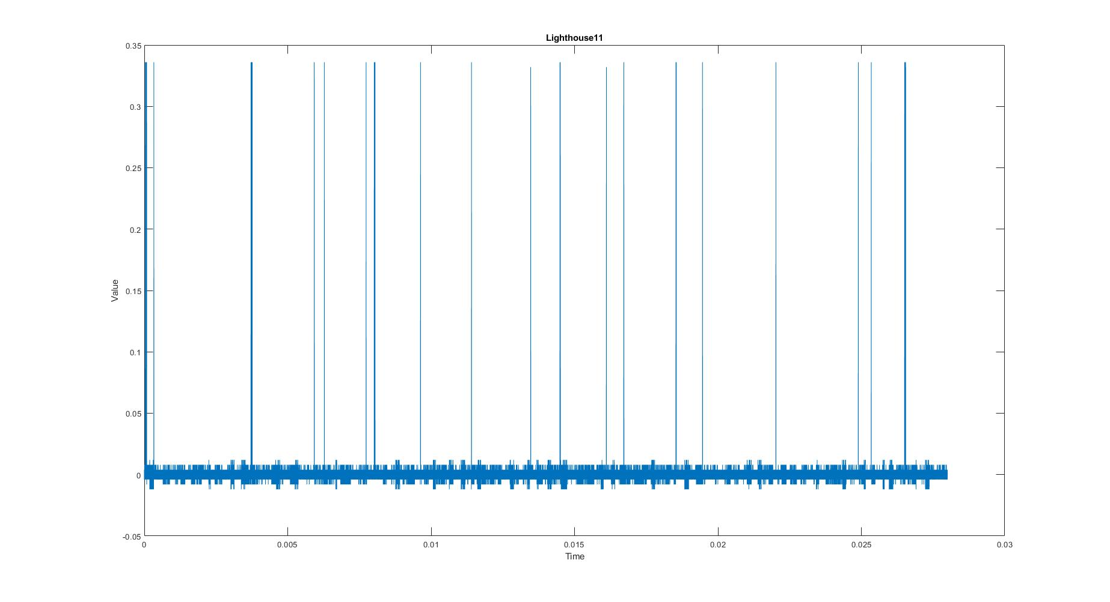
RESULTS
Figure 7: Lighthouse 1 in Position 1 – Plot of DAT-File in Matlab

Slide 18
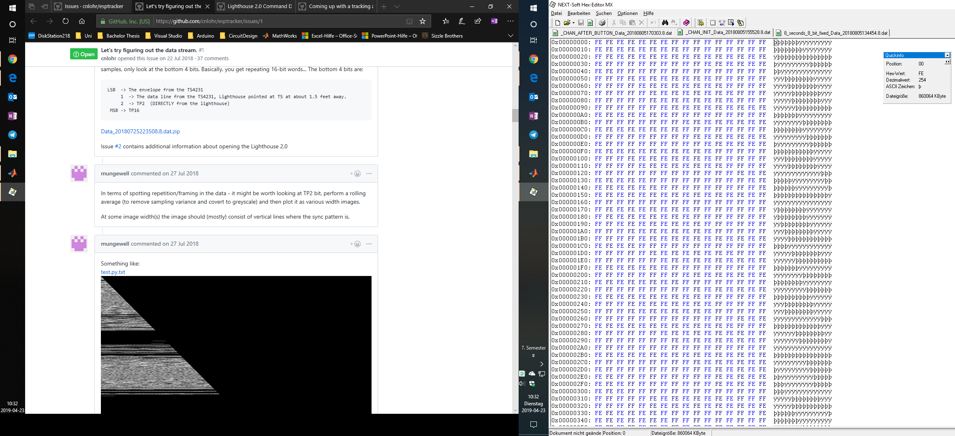
RESULTS
Figure 8: Evaluation DAT-File from GitHub Discussion [.b]

Slide 19
DISCUSSION
Adopting already Used System
Upcoming Software Updates causing Problems

Slide 20
SUMMARY
Not Able to Decode Laser Signals

Slide 21
BIBLIOGRAPHY
[.] Coming up with a tracking algorithm. URL: https://github.com/cnlohr/esptracker/issues/4.
[.2019] Base station 2.0 and controller 2.0, where are they?, 2019. URL: https://community.viveport.com/t5/General-Vive-Discussion/Base-Station-2-0 -and-Controller-2-0-Where-are-they/td-p/27446.
[.b] Let's try figuring out the data stream. URL: https://github.com/cnlohr/esptracker/issues/1.
[Bos13] Martin Bossert. Kanalcodierung. De Gruyter, München, 3., überarbeitete aufl. edition, 2013. URL: http://www.degruyter.com/search?f_0=isbnissn&q_0=9783486755169&searchTitles= true, doi:10.1524/9783486755169.
[.c] Lighthouse 2.0 command dump. URL: https://github.com/cnlohr/esptracker/issues/3.
[Cyp28] Ez-usb fx3™ superspeed usb 3.0 peripheral controller, 2019-04-28. URL: https://www.cypress.com/products/ez-usb-fx3-superspeed-usb-30-peripheral- controller.
[.d] Tearing down a vive lighthouse 2.0. - youtube. URL: https://www.youtube.com/watch?v=JP5maGaumYo.
[.e] Arduino mkr vidor 4000. URL: https://store.arduino.cc/mkr-vidor-4000.

Slide 22
BIBLIOGRAPHY
[.f] Dslogic plus – dreamsourcelab. URL: https://www.dreamsourcelab.com/product/dslogic -plus/.
[HKSK20] J. Hagenauer, G. Kramer, G. Söder, and Kötter R. Skriptum zur vorlesung nachrichtentechnik 1. 2017-04-20.
[Int] Intel cyclone 10 lp fpgas product table. URL: https://www.intel.de/content/dam/www/programmable/us/en/pdfs/literature/pt/cy clone-10-lp-product-table.pdf.
[Int17] Intel cyclone 10 lp device overview, 2017. URL: https://www.intel.de/content/dam/www/programmable/us/en/pdfs/literature/hb/ cyclone-10/c10lp-51001.pdf.
[Mic18] Sam d21 family data sheet, 2018. URL: http://ww1.microchip.com/downloads/en/DeviceDoc/ SAMD21-Family-DataSheet-DS40001882D.pdf.
[MTT12] Shivshankar Mishra, Ram Racksha Tripathi, and Devendra Kr. Tripathi. Implementation of congurable linear feedback shift register in vhdl. In 2016 International Conference on Emerging Trends in Electrical Electronics & Sustainable Energy Systems (ICETEESES), pages 342-346. IEEE, 2016-03-11 - 2016-03-12. doi:10.1109/ICETEESES.2016.7581406.

Slide 23
BIBLIOGRAPHY
[PP16] Christof Paar and Jan Pelzl. Kryptograe verständlich: Ein Lehrbuch für Studierende und Anwender. eXamen.press. Springer Vieweg, Berlin and Heidelberg, 2016. URL: http://dx.doi.org/10.1007/ 978-3-662-49297-0, doi:10.1007/978-3-662-49297-0.
[Sei] John Seibel. How to congure the ts4231 with arduino. URL: http://help.triadsemi.com/ts4231- light-to-digital-ic-with-data-output/how-to-configure-the-ts4231-with-arduino.
[Tri16a] Ts4231 design guidelines, 2016. URL: https://www.triadsemi.com/wp- content/uploads/2017/06/TS4231-Design-Guidelines.pdf.
[Tri16b] Ts4231 light to digital converter product datasheet, 2016. URL: https://www.triadsemi.com/wp- content/uploads/2017/06/TS4231-Datasheet.pdf.
[TSG16] Ulrich Tietze, Christoph Schenk, and Eberhard Gamm. Halbleiter-Schaltungstechnik. Springer Vieweg, Berlin and Heidelberg, 15.,überarbeitete und erweiterte auflage edition, 2016.
[Vis17] Bpw34, bpw34s, 2017. URL: https://www.vishay.com/docs/81521/bpw34.pdf.
[Wak06] John F. Wakerly. Digital design: Principles and practices. Pearson Prentice Hall, Upper Saddle River, NJ, 4. ed. edition, 2006.

Slide 24
GENERAL RULES
for a uniformly presentation appearance
Fonts: Lato / Lato Light / Lato black
Headlines: The headline style is always in capital letters (Lato Black). The subtitle is in small letters (Lato Light) and shifted. It gives a short introduction to the topic (sometimes in a funny way).
Do not put too much text & bullet points on your slides. This might distract people's attention and they won‘t listen on what you are saying.
Ideally: Have just one message per slide, make it a sentence that is short & concise!

Slide 25




DON’TS
i am a witty subtitle, put me at the right place
The subtitle goes partially below the title and ends on the right outside of the title
YES
NO
The subtitle is all lower-case,
including the first letter

Slide 26
DONT’S - TITLE
i am a witty subtitle, but don’t matter in this slide
I am a Title
i am a witty subtitle, but don’t matter in this slide
I AM A TITLE
i am a witty subtitle, but don’t matter in this slide
NO
YES

Slide 27
TEXT ON A SLIDE
how to put it the right way
I am some generic text in Lato light
I am a important and have to be highlighted in Lato Black
List items have a dot in front!
I am Roboy Blue
I am some text that is not highlighted and still Lato Black
I am a list item with a dash in front
I am black text!
YES
NO

Slide 28

SLIDE STRUCTURE
for a good visual cue
If you want to show that there are multiple things (e.g. robotics, computer science,…) display them as keywords and put an icon, like in the example below:

Slide 29
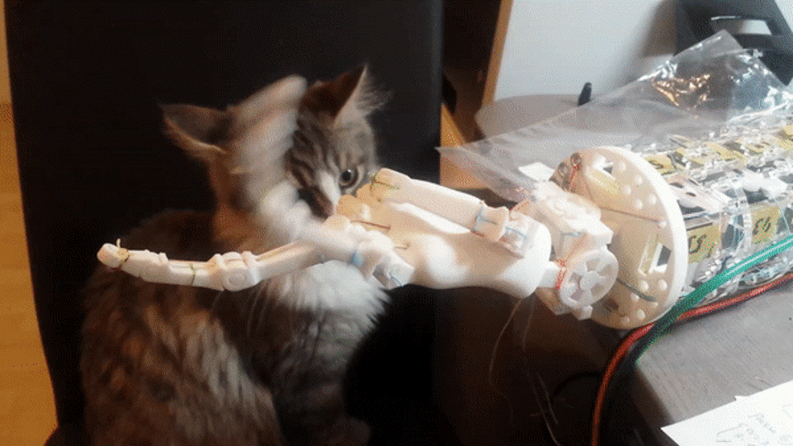
GET ATTENTION
by showing videos, gif’s & pictures
•Use the guides as orientation for placing your pictures / videos.
•In the following slides you find examples for aligning your pictures.

Slide 30
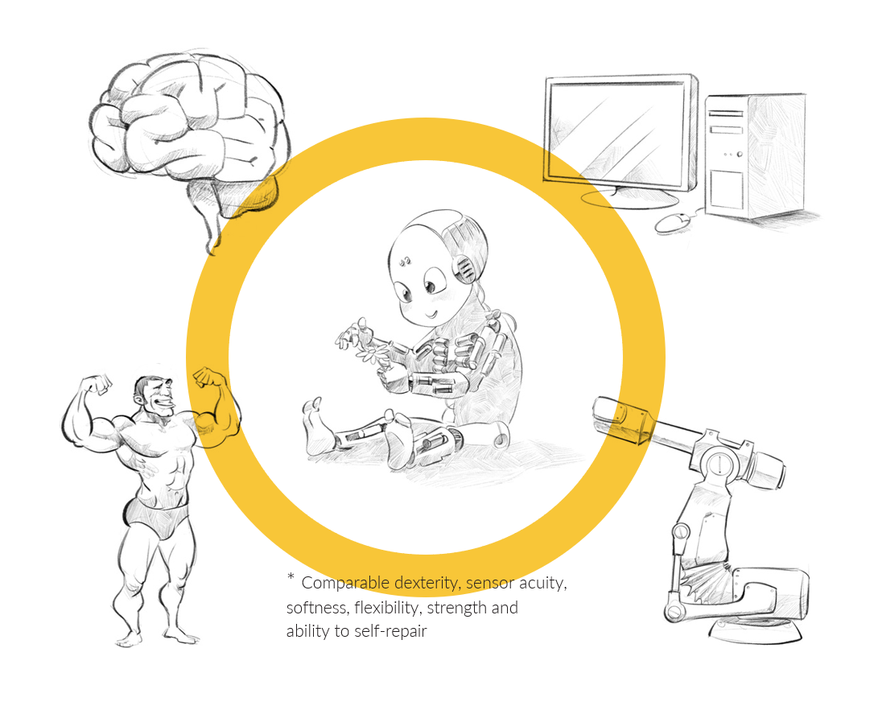
EXAMPLE 1
where to place your pictures
If you have just one picture like in this example, put it in the center of the lower part.

Slide 31
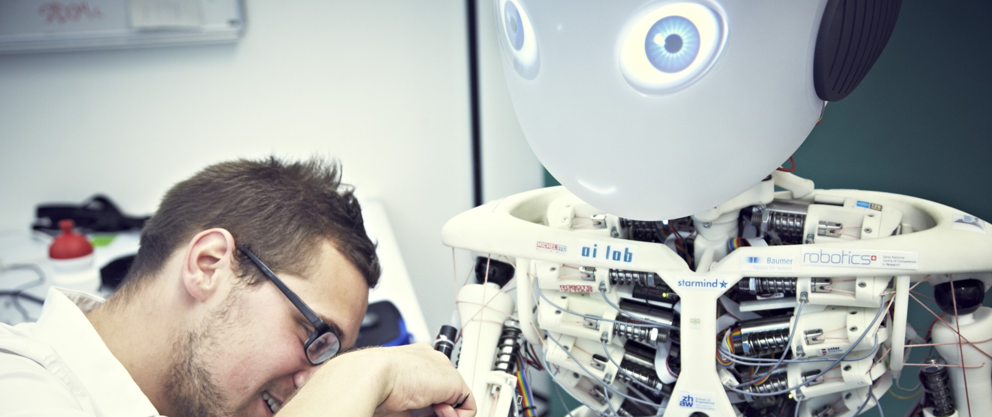
EXAMPLE 2
where to place your pictures
Use the existing picture for the alignment of your pictures

Slide 32
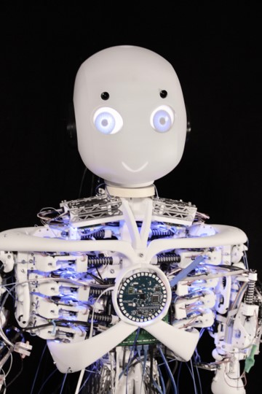
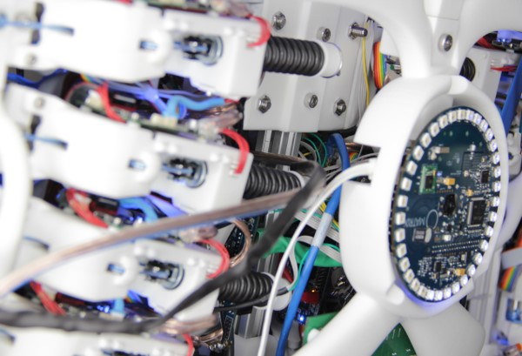
EXAMPLE 2
where to place your pictures
Use the existing picture for the alignment of your pictures

Slide 33
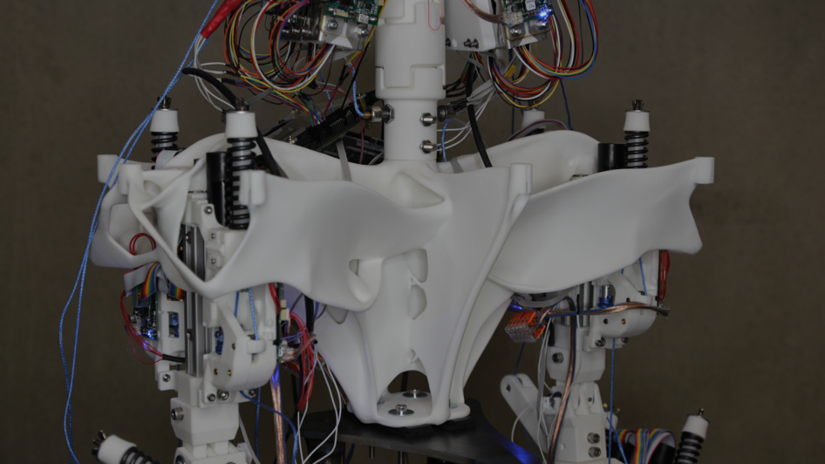
EXAMPLE 3
where to place your pictures
Placing your picture all over the slide is also an option. Please make sure that the font is still good readable. Do not put a white font over a bright background!

Slide 34
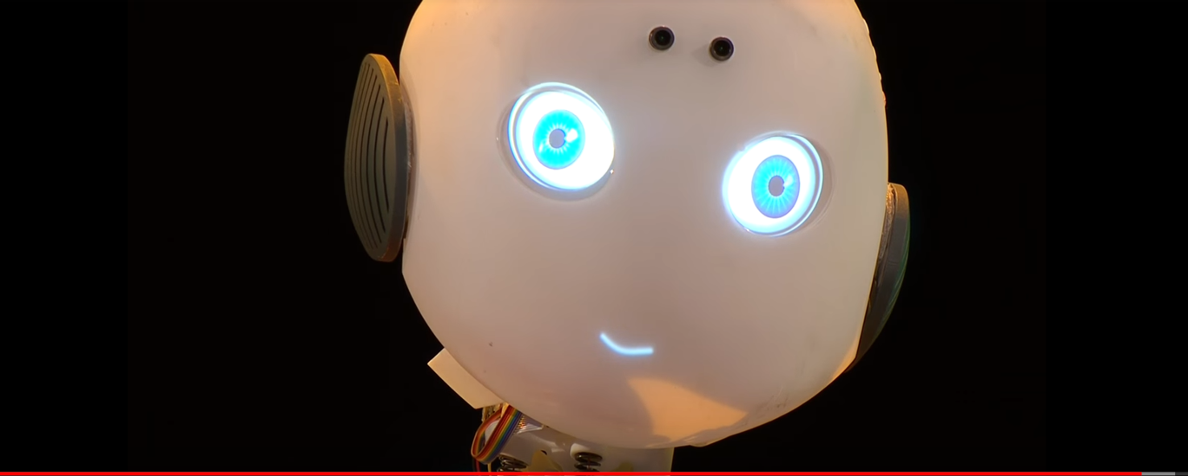
THAT’S IT
wish you all the best for your final presentations :)
Find previous presentations: https://roboy.org/projects/

